Slide 1
Software engineering course
Asre Dadeh Afzar Tehran
Mehdi Zaferani

Slide 2
Software engineering principles

Slide 3
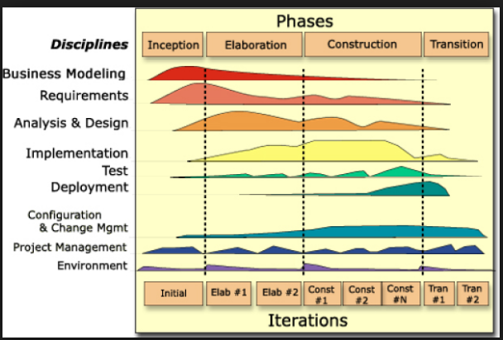
Software development methodologies
Waterfall:
Analysis → Design → Implement → Test → Deploy → Maintenance
International incremental

Slide 4
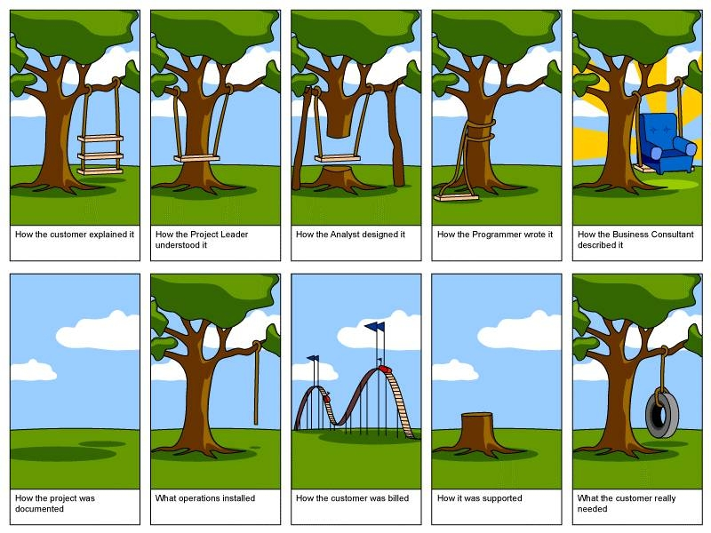
Different perspectives

Slide 5
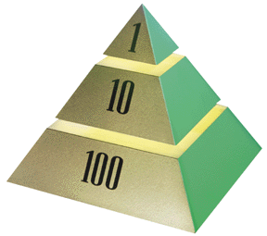
The High Cost of Requirement Errors
The 1-10-100 Rule
Stage
.5 - 1
Requirements Time
2.5
Design
5
Coding
10
Unit Test
25
Acceptance Test
100
Maintenance
Relative cost to repair errors: When introduced vs. when repaired
Notes:
The most expensive errors to correct are those introduced at Requirements Time and not found until after release to the customer.
Note: These same errors are also the least expensive to correct if found during Requirements Time. The longer they exist, the more expensive they become.
Use this slide to explain the 1-10-100 rule.
Start by saying that before you get to the actual costs, let’s illustrate the costs with some real examples.
Ask if there is anybody in the class who writes requirements specifications. Ask him/her what they need to correct an error in a requirement BEFORE the Requirements Specification is released for the first time. The answer is probably to get approval and to change the text.
Then ask if somebody in the class is a tester. Ask him/her what they need to do to correct an error they find during acceptance test. The answer is probably very lengthy. Point out the difference in cost between fixing a requirement initially and during testing.
Now explain the 1-10-100 rule by pointing to the pyramid. The figures are the order-of-magnitude relative costs of fixing a requirement error during requirements capture, coding, and testing. You can mention the Boehm and Grady studies that found similar relative costs. Stay away from getting caught up in the fractions and other details.
Help students understand that requirement errors are obviously the most expensive cost if they are not discovered until later in the lifecycle.

Slide 6
RUP Methodology

Slide 7
RUP Methodology

Slide 8
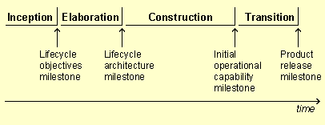
RUP Milestones

Slide 9
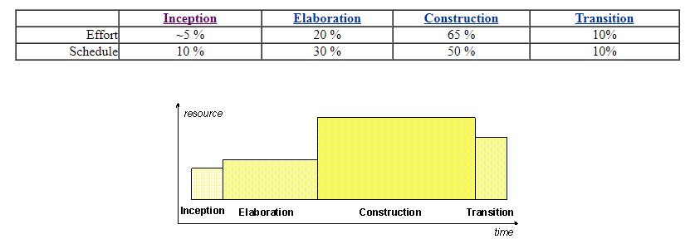
Planning
All phases are not identical in terms of schedule and effort. Although this varies considerably depending on the project, a typical initial development cycle for a medium-sized project should anticipate the following distribution between effort and schedule:

Slide 10
Evolution
For an evolution cycle, the inception and elaboration phases would be considerably smaller. Tools which can automate some portion of the Construction effort can mitigate this, making the construction phase much smaller than the inception and elaboration phases together.
One pass through the four phases is a development cycle; each pass through the four phases produces a generation of the software. Unless the product "dies," it will evolve into its next generation by repeating the same sequence of inception, elaboration, construction and transition phases, but this time with a different emphasis on the various phases. These subsequent cycles are called evolution cycles. As the product goes through several cycles, new generations are produced.

Slide 11
Evolution- Continued
Evolution cycles may be triggered by user-suggested enhancements, changes in the user context, changes in the underlying technology, reaction to the competition, and so on. Evolution cycles typically have much shorter Inception and Elaboration phases, since the basic product definition and architecture are determined by prior development cycles. Exceptions to this rule are evolution cycles in which a significant product or architectural redefinition occurs.

Slide 12
RUP phases First phase: Inception
The overriding goal of the inception phase is to achieve concurrence among all stakeholders on the lifecycle objectives for the project. The inception phase is of significance primarily for new development efforts, in which there are significant business and requirements risks which must be addressed before the project can proceed. For projects focused on enhancements to an existing system, the inception phase is more brief, but is still focused on ensuring that the project is both worth doing and possible to do.

Slide 13
RUP phases First phase: Inception
The primary objectives of the inception phase include:
Establishing the project's software scope and boundary conditions, including an operational vision, acceptance criteria and what is intended to be in the product and what is not.
Discriminating the critical use cases of the system, the primary scenarios of operation that will drive the major design trade-offs.
Exhibiting, and maybe demonstrating, at least one candidate architecture against some of the primary scenarios
Estimating the overall cost and schedule for the entire project (and more detailed estimates for the elaboration phase that will immediately follow)
Estimating potential risks (the sources of unpredictability) (See Concepts: Risk)
Preparing the supporting environment for the project.

Slide 14
RUP phases First phase: Inception
Essential activities
Formulating the scope of the project. This involves capturing the context and the most important requirements and constraints to such an extent that you can derive acceptance criteria for the end product.
Planning and preparing a business case. Evaluating alternatives for risk management, staffing, project plan, and cost/schedule/profitability trade-offs.
Synthesizing a candidate architecture, evaluating trade-offs in design, and in make/buy/reuse, so that cost, schedule and resources can be estimated. The aim here is to demonstrate feasibility through some kind of proof of concept. This may take the form of a model which simulates what is required, or an initial prototype which explores what are considered to be the areas of high risk. The prototyping effort during inception should be limited to gaining confidence that a solution is possible - the solution is realized during elaboration and construction.
Preparing the environment for the project, assessing the project and the organization, selecting tools, deciding which parts of the process to improve.

Slide 15
RUP phases First phase: Inception
At the end of the inception phase is the first major project milestone or Lifecycle Objectives Milestone. At this point, you examine the lifecycle objectives of the project, and decide either to proceed with the project or to cancel it.
Evaluation Criteria:
Stakeholder concurrence on scope definition and cost/schedule estimates
Agreement that the right set of requirements have been captured and that there is a shared understanding of these requirements.
Agreement that the cost/schedule estimates, priorities, risks, and development process are appropriate.
All risks have been identified and a mitigation strategy exists for each.
The project may be aborted or considerably re-thought if it fails to reach this milestone.

Slide 16
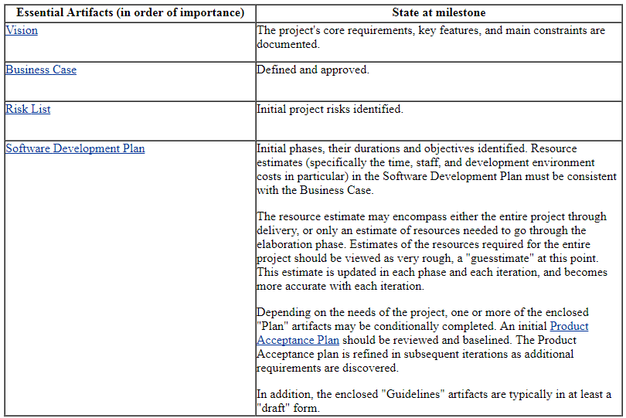
RUP phases First phase: Inception- Artifacts
Deliverables and artifacts:

Slide 17
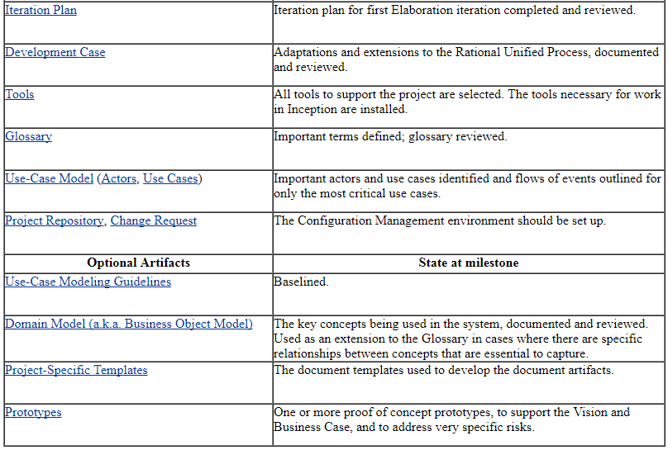
RUP phases First phase: Inception- Artifacts

Slide 18
RUP phases Second phase: Elaboration
The goal of the elaboration phase is to baseline the architecture of the system to provide a stable basis for the bulk of the design and implementation effort in the construction phase. The architecture evolves out of a consideration of the most significant requirements (those that have a great impact on the architecture of the system) and an assessment of risk. The stability of the architecture is evaluated through one or more architectural prototypes.

Slide 19
RUP phases Second phase: Elaboration
The primary objectives of the elaboration phase include:
To ensure that the architecture, requirements and plans are stable enough, and the risks sufficiently mitigated to be able to predictably determine the cost and schedule for the completion of the development. For most projects, passing this milestone also corresponds to the transition from a light-and-fast, low-risk operation to a high cost, high risk operation with substantial organizational inertia.
To address all architecturally significant risks of the project
To establish a baselined architecture derived from addressing the architecturally significant scenarios, which typically expose the top technical risks of the project.
To produce an evolutionary prototype of production-quality components, as well as possibly one or more exploratory, throw-away prototypes to mitigate specific risks such as:
design/requirements trade-offs
component reuse
product feasibility or demonstrations to investors, customers, and end-users.
To demonstrate that the baselined architecture will support the requirements of the system at a reasonable cost and in a reasonable time.
To establish a supporting environment.
In order to achieve this primary objectives, it is equally important to set up the supporting environment for the project. This includes creating a development case, create templates, guidelines, and setting up tools.

Slide 20
RUP phases Second phase: Elaboration
Essential activities
Defining, validating and baselining the architecture as rapidly as practical.
Refining the Vision, based on new information obtained during the phase, establishing a solid understanding of the most critical use cases that drive the architectural and planning decisions.
Creating and baselining detailed iteration plans for the construction phase.
Refining the development case and putting in place the development environment, including the process, tools and automation support required to support the construction team.
Refining the architecture and selecting components. Potential components are evaluated and the make/buy/reuse decisions sufficiently understood to determine the construction phase cost and schedule with confidence. The selected architectural components are integrated and assessed against the primary scenarios. Lessons learned from these activities may well result in a redesign of the architecture, taking into consideration alternative designs or reconsideration of the requirements.

Slide 21
RUP phases Second phase: Elaboration
At the end of the elaboration phase is the second important project milestone, the Lifecycle Architecture Milestone. At this point, you examine the detailed system objectives and scope, the choice of architecture, and the resolution of the major risks.
Evaluation Criteria
The product Vision and requirements are stable.
The architecture is stable.
The key approaches to be used in test and evaluation are proven.
Test and evaluation of executable prototypes have demonstrated that the major risk elements have been addressed and have been credibly resolved.
The iteration plans for the construction phase are of sufficient detail and fidelity to allow the work to proceed.
The iteration plans for the construction phase are supported by credible estimates.
All stakeholders agree that the current vision can be met if the current plan is executed to develop the complete system, in the context of the current architecture.
Actual resource expenditure versus planned expenditure are acceptable.
The project may be aborted or considerably re-thought if it fails to reach this milestone.

Slide 22
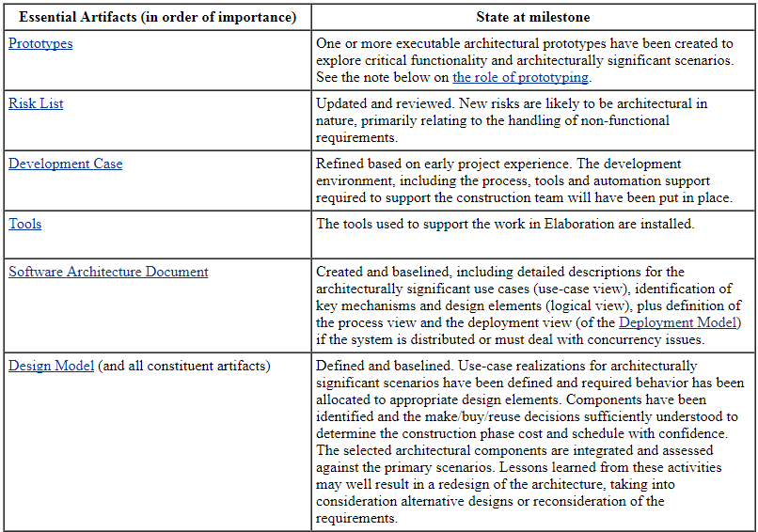
RUP phases Second phase: Elaboration Artifacts
Deliverables and artifacts:

Slide 23
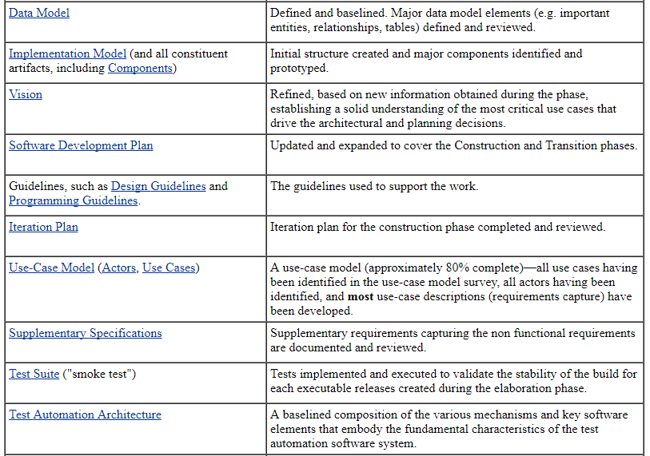
RUP phases Second phase: Elaboration Artifacts
Deliverables and artifacts:

Slide 24
RUP phases Second phase: Elaboration Artifacts
Deliverables and artifacts:

Slide 25
RUP phases Third phase: Construction
The goal of the construction phase is on clarifying the remaining requirements and completing the development of the system based upon the baselined architecture. The construction phase is in some sense a manufacturing process, where emphasis is placed on managing resources and controlling operations to optimize costs, schedules, and quality. In this sense the management mindset undergoes a transition from the development of intellectual property during inception and elaboration, to the development of deployable products during construction and transition.

Slide 26
RUP phases Third phase: Construction
The primary objectives of the construction phase include:
Minimizing development costs by optimizing resources and avoiding unnecessary scrap and rework.
Achieving adequate quality as rapidly as practical
Achieving useful versions (alpha, beta, and other test releases) as rapidly as practical
Completing the analysis, design, development and testing of all required functionality.
To iteratively and incrementally develop a complete product that is ready to transition to its user community. This implies describing the remaining use cases and other requirements, fleshing out the design, completing the implementation, and testing the software.
To decide if the software, the sites, and the users are all ready for the application to be deployed.
To achieve some degree of parallelism in the work of development teams. Even on smaller projects, there are typically components that can be developed independently of one another, allowing for natural parallelism between teams (resources permitting). This parallelism can accelerate the development activities significantly; but it also increases the complexity of resource management and workflow synchronization. A robust architecture is essential if any significant parallelism is to be achieved.

Slide 27
RUP phases Third phase: Construction
Essential Activities
Resource management, control and process optimization
Complete component development and testing against the defined evaluation criteria
Assessment of product releases against acceptance criteria for the vision.

Slide 28
RUP phases Third phase: Construction
At the Initial Operational Capability Milestone, the product is ready to be handed over to the Transition Team. All functionality has been developed and all alpha testing (if any) has been completed. In addition to the software, a user manual has been developed, and there is a description of the current release.
Evaluation Criteria
The evaluation criteria for the construction phase involve the answers to these questions:
Is this product release stable and mature enough to be deployed in the user community?
Are all the stakeholders ready for the transition into the user community?
Are actual resource expenditures versus planned still acceptable?
Transition may have to be postponed by one release if the project fails to reach this milestone.

Slide 29
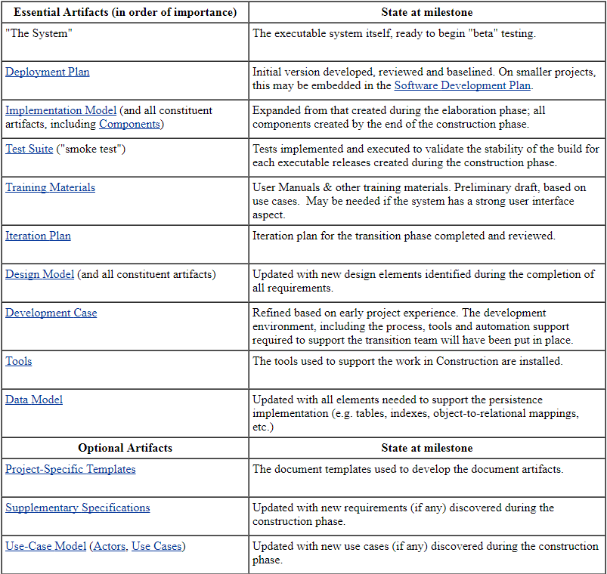
RUP phases Third phase: Construction Artifacts
Deliverables and artifacts:

Slide 30
RUP phases Third phase: Construction Artifacts
Deliverables and artifacts:

Slide 31
RUP phases Third phase: Construction Artifacts
Deliverables and artifacts:

Slide 32
RUP phases Forth phase: Transition
The focus of the Transition Phase is to ensure that software is available for its end users. The Transition Phase can span several iterations, and includes testing the product in preparation for release, and making minor adjustments based on user feedback. At this point in the lifecycle, user feedback should focus mainly on fine tuning the product, configuring, installing and usability issues, all the major structural issues should have been worked out much earlier in the project lifecycle. By the end of the Transition Phase lifecycle objectives should have been met and the project should be in a position to be closed out. In some cases, the end of the current life cycle may coincide with the start of another lifecycle on the same product, leading to the next generation or version of the product. For other projects, the end of Transition may coincide with a complete delivery of the artifacts to a third party who may be responsible for operations, maintenance and enhancements of the delivered system. This Transition Phase ranges from being very straightforward to extremely complex, depending on the kind of product. A new release of an existing desktop product may be very simple, whereas the replacement of a nation's air-traffic control system may be exceedingly complex. Activities performed during an iteration in the Transition Phase depend on the goal. For example, when fixing bugs, implementation and test are usually enough. If, however, new features have to be added, the iteration is similar to one in the construction phase requiring analysis&design, etc. The Transition Phase is entered when a baseline is mature enough to be deployed in the end-user domain. This typically requires that some usable subset of the system has been completed with acceptable quality level and user documentation so that transitioning to the user provides positive results for all parties.

Slide 33
RUP phases Forth phase: Transition
The primary objectives of the Transition Phase are:
beta testing to validate the new system against user expectations
beta testing and parallel operation relative to a legacy system that it's replacing
converting operational databases
training of users and maintainers
roll-out to the marketing, distribution and sales forces
deployment-specific engineering such as cutover, commercial packaging and production, sales roll-out, field personnel training
tuning activities such as bug fixing, enhancement for performance and usability
assessment of the deployment baselines against the complete vision and the acceptance criteria for the product
achieving user self-supportability
achieving stakeholder concurrence that deployment baselines are complete
achieving stakeholder concurrence that deployment baselines are consistent with the evaluation criteria of the vision

Slide 34
RUP phases Forth phase: Transition
Essential activities
executing deployment plans
finalizing end-user support material
testing the deliverable product at the development site
creating a product release
getting user feedback
fine-tuning the product based on feedback
making the product available to end users

Slide 35
RUP phases Forth phase: Transition
At the end of the transition phase is the fourth important project milestone, the Product Release Milestone. At this point, you decide if the objectives were met, and if you should start another development cycle. In some cases this milestone may coincide with the end of the inception phase for the next cycle. The Product Release Milestone is the result of successful completion of the Activity: Project Acceptance Review.
Evaluation Criteria
The primary evaluation criteria for the transition phase involve the answers to these questions:
Is the user satisfied?
Are actual resources expenditures versus planned expenditures acceptable?
At the Product Release Milestone, the product is in production and the post-release maintenance cycle begins. This may involve starting a new cycle, or some additional maintenance release.

Slide 36
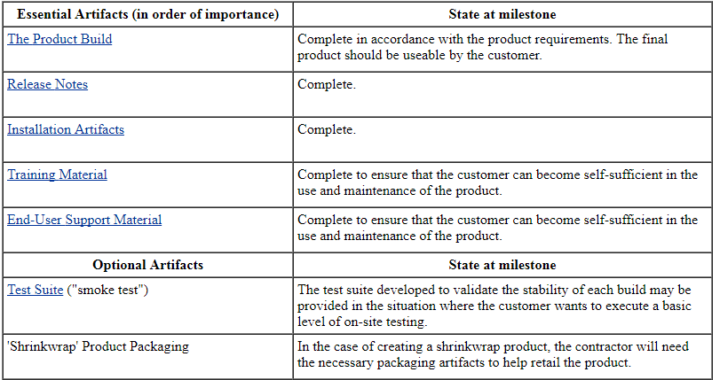
RUP phases Forth phase: Transition
Deliverables and artifacts:

Slide 37
RUP phases Third phase: Construction Artifacts
Deliverables and artifacts:

Slide 38
RUP phases Third phase: Construction Artifacts
Deliverables and artifacts:

Slide 39
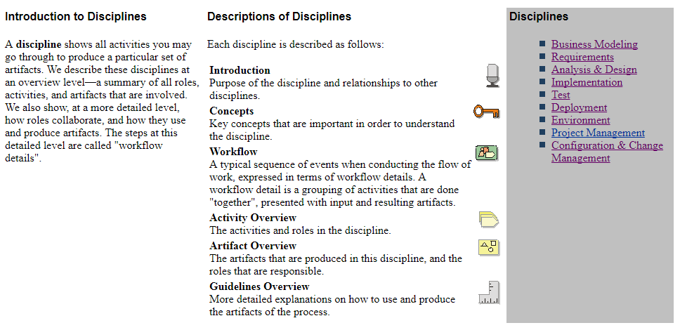
Disciplines

Slide 40
Disciplines Business Modeling

Slide 41
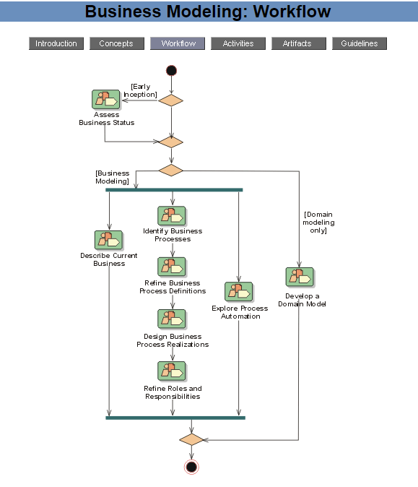
Disciplines Business Modeling

Slide 42
Disciplines Business Modeling

Slide 43
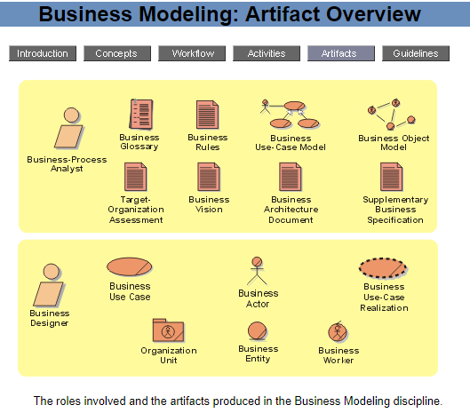
Disciplines Business Modeling

Slide 44
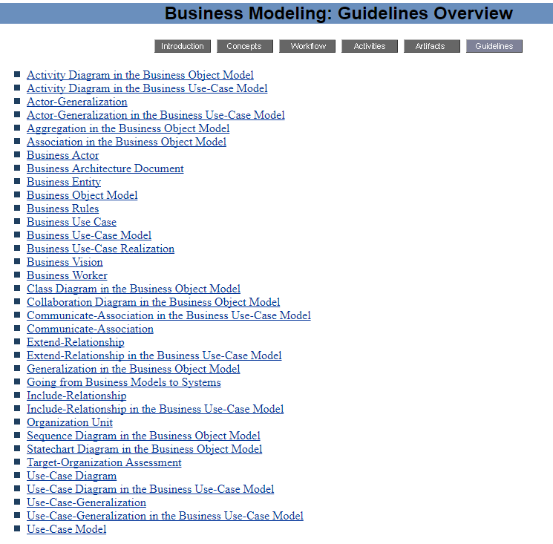
Disciplines Business Modeling

Slide 45
Disciplines Requirements

Slide 46
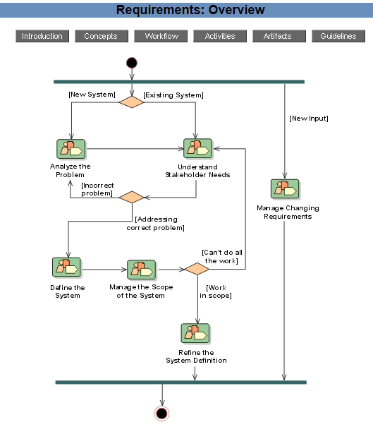
Disciplines Requirements

Slide 47
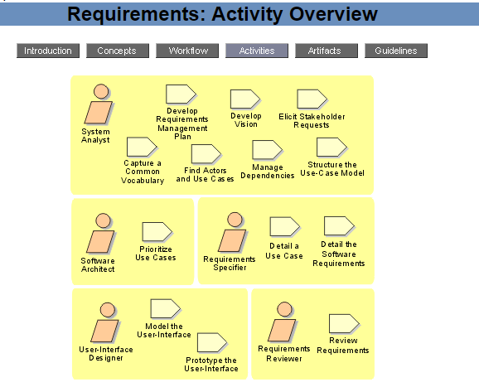
Disciplines Requirements

Slide 48
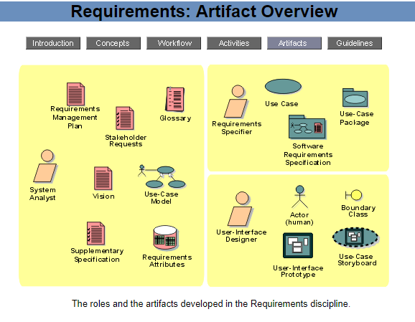
Disciplines Requirements

Slide 49
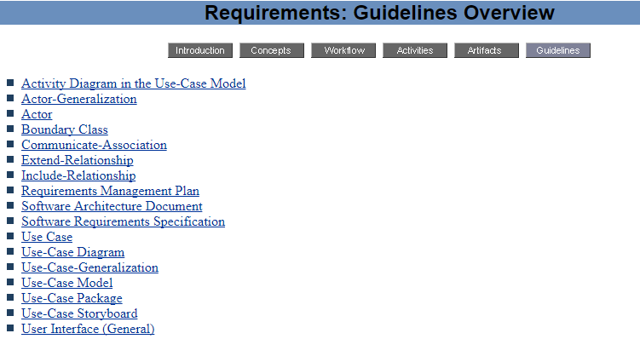
Disciplines Requirements

Slide 50
Disciplines Analysis &Design

Slide 51
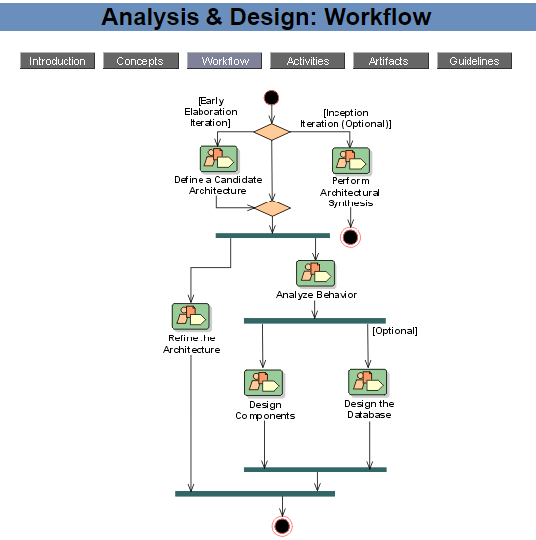
Disciplines Analysis &Design

Slide 52
Disciplines Analysis &Design

Slide 53
Disciplines Analysis &Design

Slide 54
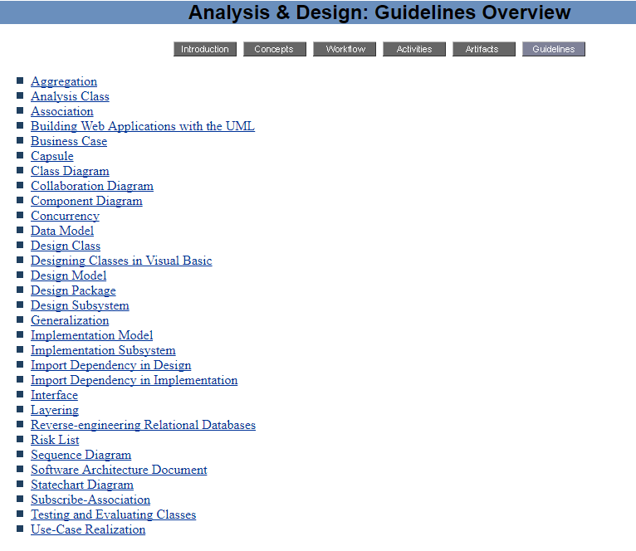
Disciplines Analysis &Design

Slide 55
Disciplines Implementation

Slide 56
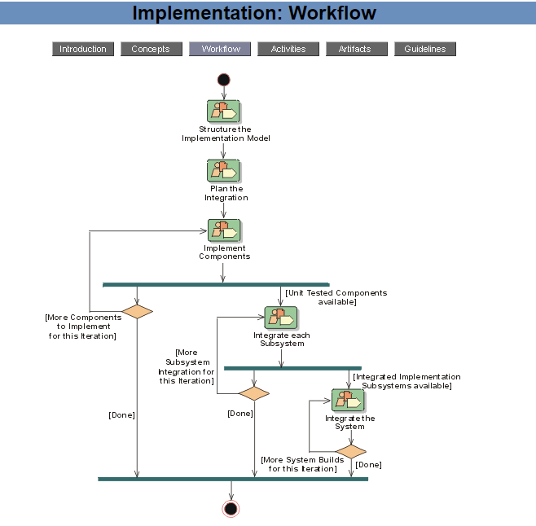
Disciplines Implementation

Slide 57
Disciplines Implementation

Slide 58
Disciplines Implementation

Slide 59
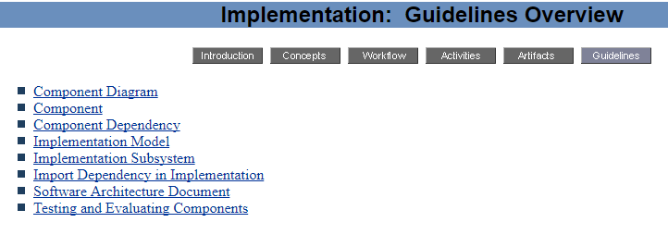
Disciplines Implementation

Slide 60
Disciplines Test

Slide 61
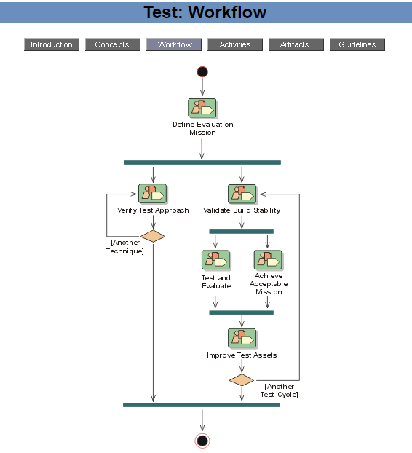
Disciplines Test

Slide 62
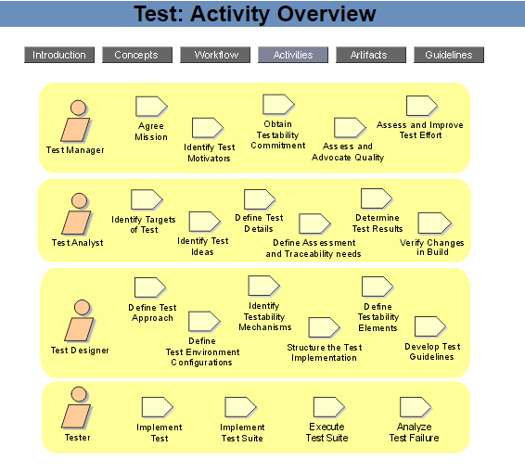
Disciplines Test

Slide 63
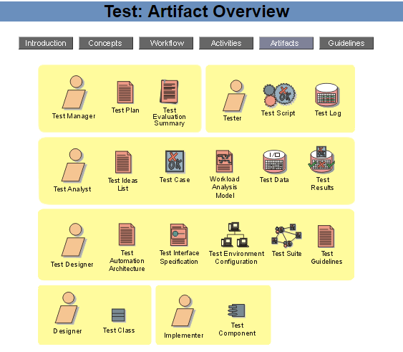
Disciplines Test

Slide 64
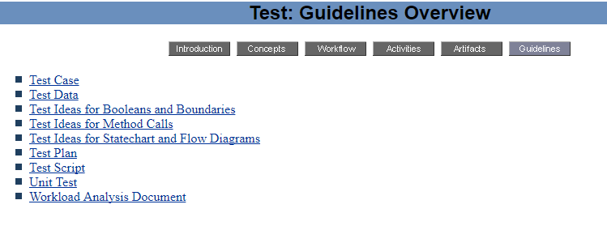
Disciplines Test

Slide 65
Disciplines Deployment

Slide 66
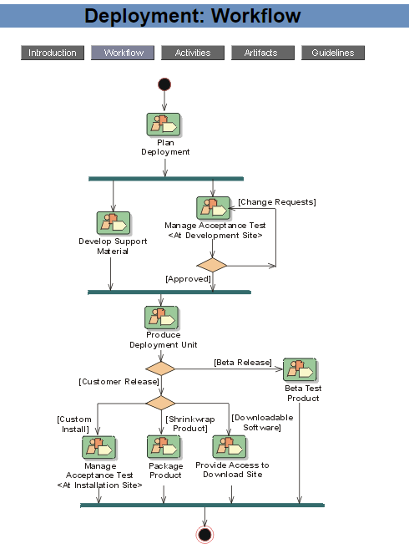
Disciplines Deployment

Slide 67
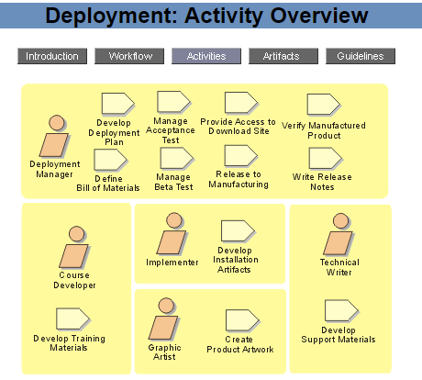
Disciplines Deployment

Slide 68
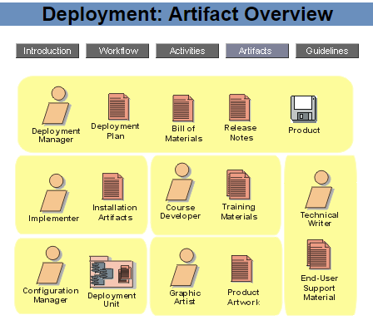
Disciplines Deployment

Slide 69
Disciplines Deployment

Slide 70
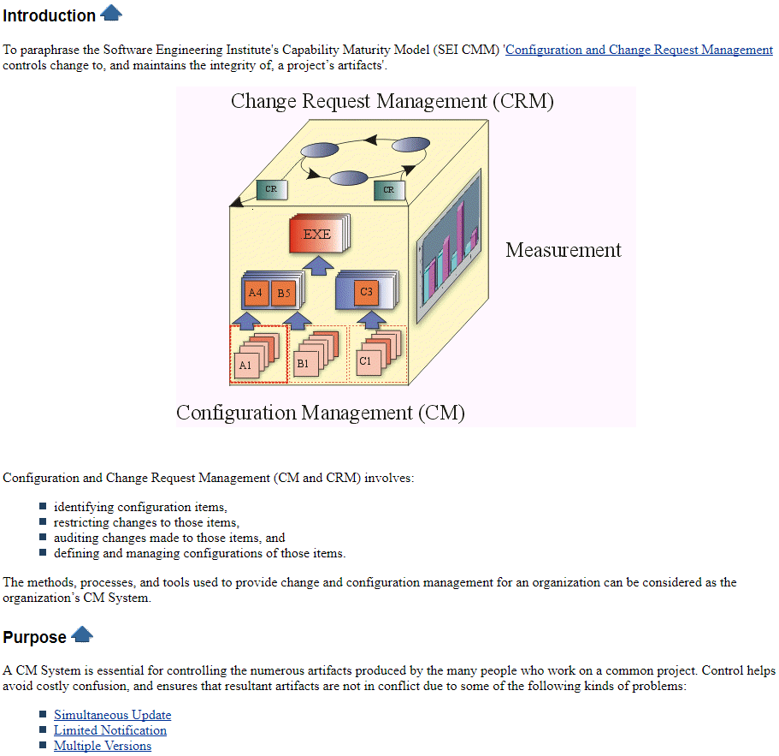
Disciplines Configuration & Change Management

Slide 71
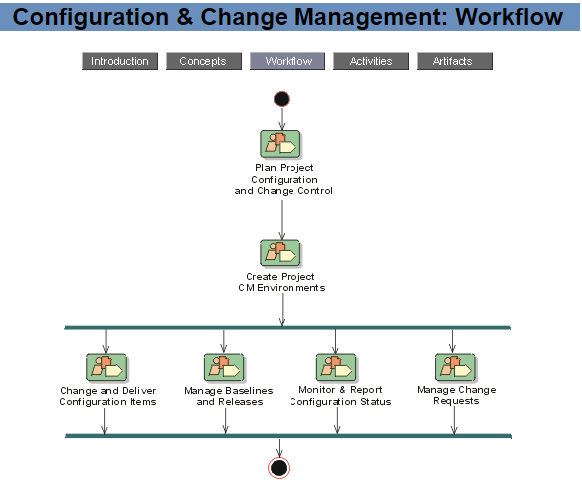
Disciplines Configuration & Change Management

Slide 72
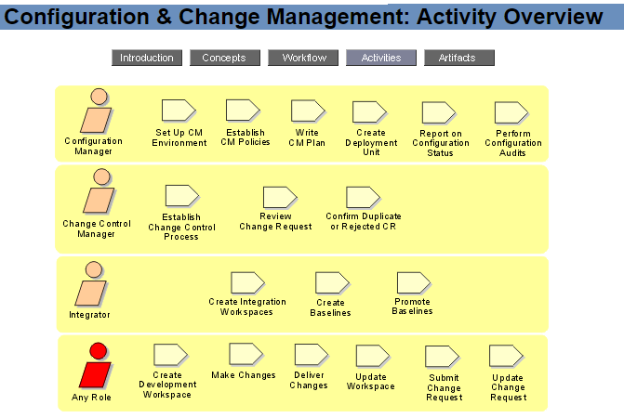
Disciplines Configuration & Change Management

Slide 73
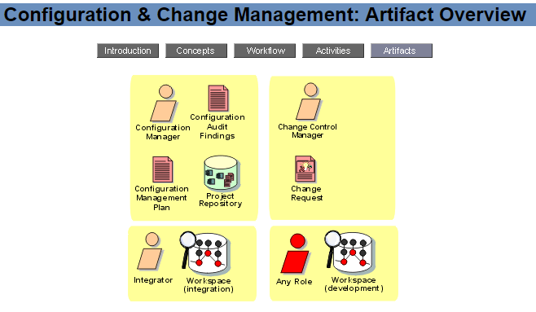
Disciplines Configuration & Change Management

Slide 74
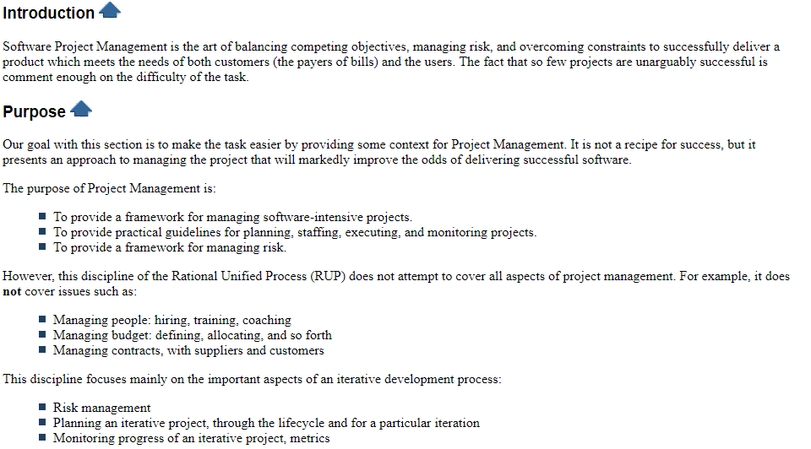
Disciplines Project Management

Slide 75
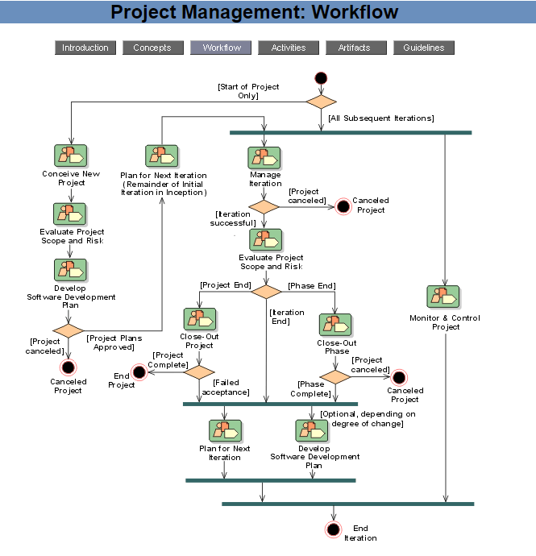
Disciplines Project Management

Slide 76
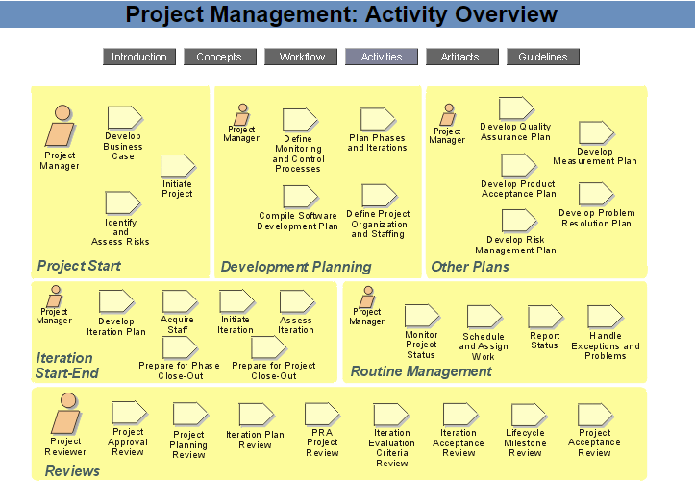
Disciplines Project Management

Slide 77
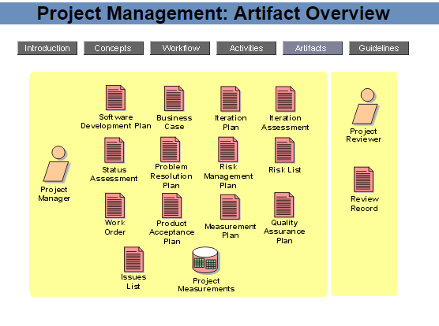
Disciplines Project Management

Slide 78
Disciplines Project Management

Slide 79
Disciplines Environment

Slide 80
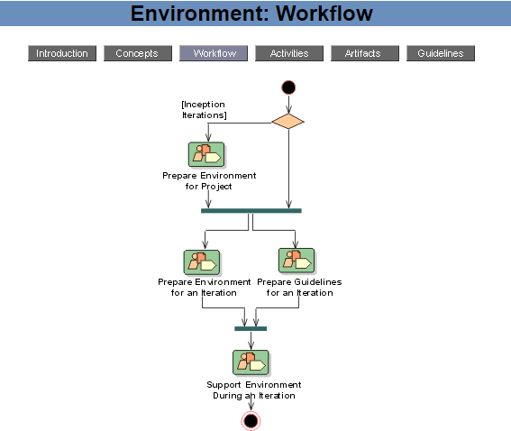
Disciplines Environment

Slide 81
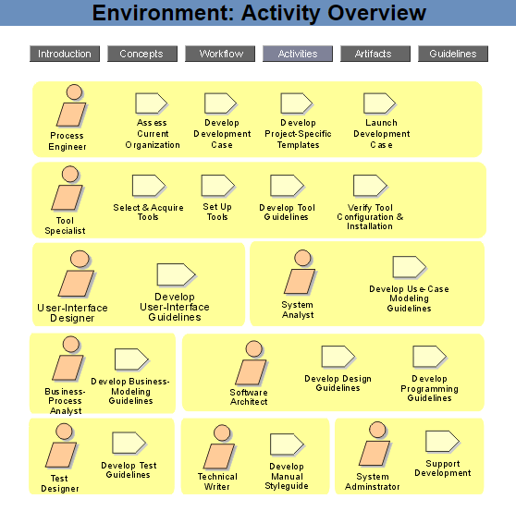
Disciplines Environment

Slide 82
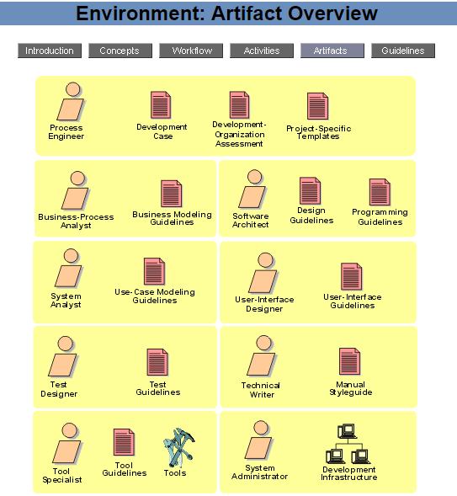
Disciplines Environment

Slide 83
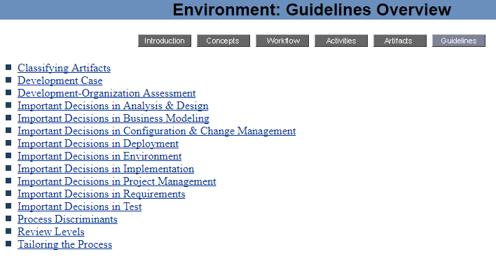
Disciplines Environment

Slide 84
منابع:
Software Engineering: A Practitioner's Approach Paperback – 1 Apr 2009
http://sce.uhcl.edu/helm/RationalUnifiedProcess/
مرجع کاربردی متدولوژی RUP برای تولید و توسعه سیستم‌های نرم‌افزاری
ناشر: دانشگاه اصفهان. پدیدآوران: گردآورنده: مهدی گل‌محمدی, احمد براآنی, ناصر نعمت‌بخش, مرتضی مسلمی‌فر, سعید حاجبی.

Slide 85
پرسش و پاسخ

